Slide 1
You probably clicked the link because…

Slide 2
You can’t focus for 10+ minutes
You leave revision for too late (2 weeks prior to exams)
You are tired from just re-reading and highlighting
You struggle with burn-outs and demotivation
You have spent hours studying but retain nothing

Slide 3
GOOD NEWS: You have found the right place

Slide 4
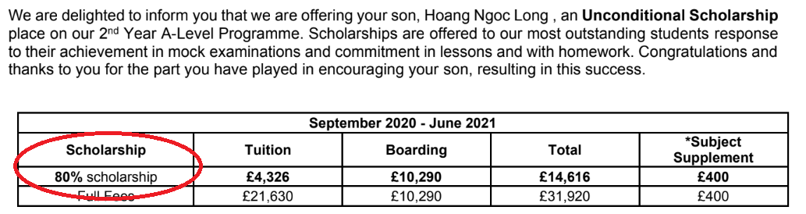
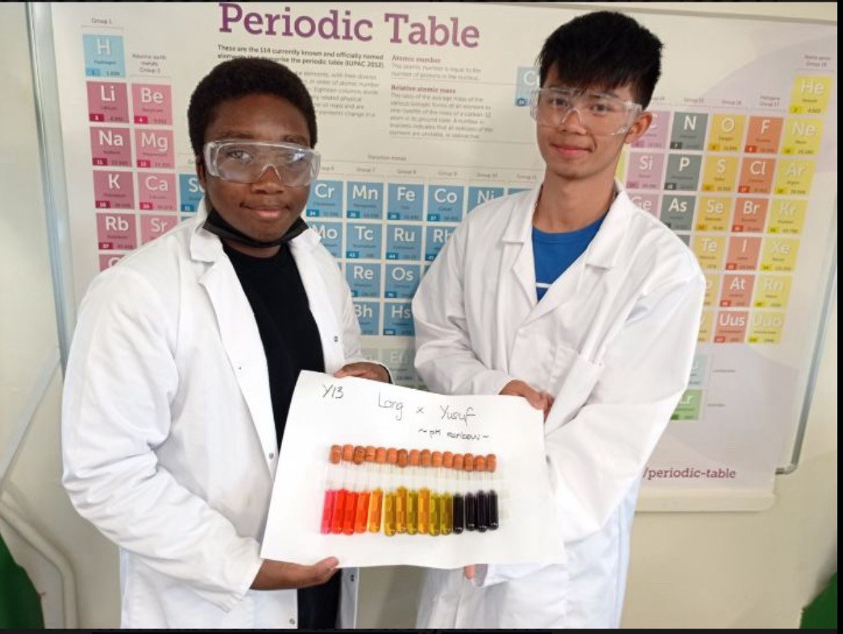
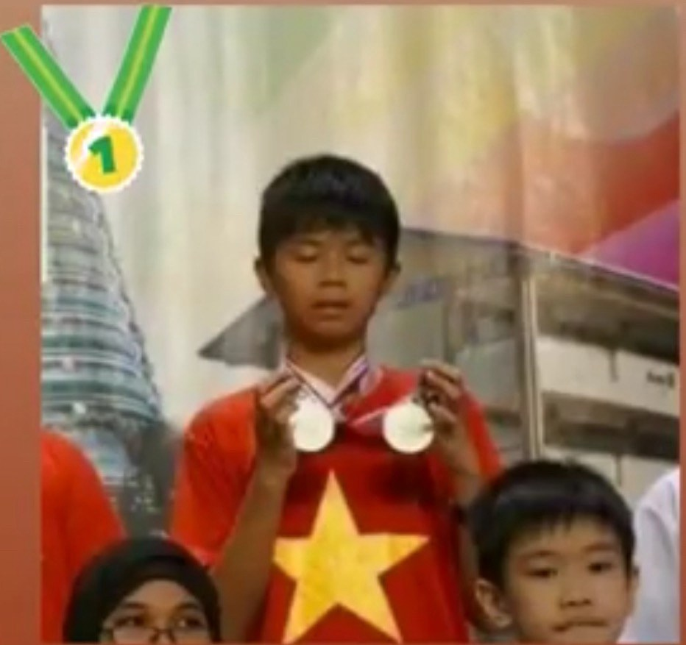
About me

Slide 5
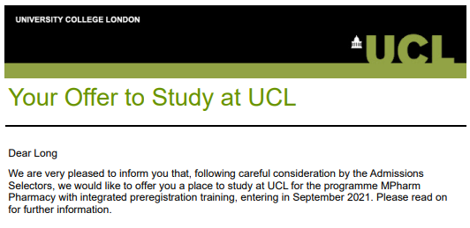
9th (world)

Slide 6
Ready???

Slide 7
Today’s Objectives…

Slide 8
3 common misunderstandings
3 common obstacles to success
How to use resources
My gift at the end

Slide 9
Ask yourself this before anything…

Slide 10
30 mins
Knowing exactly how to plan your day so you don’t waste time wondering where to start
Exact technique top students use to remember 3x more in half the time - and you’ll try it today
Understand why your revision hasn’t worked… and how to fix it with one simple mindset shift

Slide 11
Lock In (by turning off your phone/distractors)

Slide 12
More hours ≠ Higher grades

Slide 13


Slide 14


Slide 15
vs
More hours ➔ Same grades
More hours ➔ Higher grades

Slide 16
He knows something that the farmer doesn’t know…

Slide 17
Flashcard Myths

Slide 18

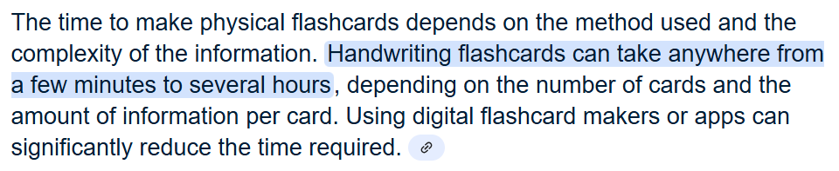

Slide 19
Several hours … for ONE TOPIC??

Slide 20
Digital MCQs – Powered by AI >>>>

Slide 21
Motivation or Discipline?

Slide 22
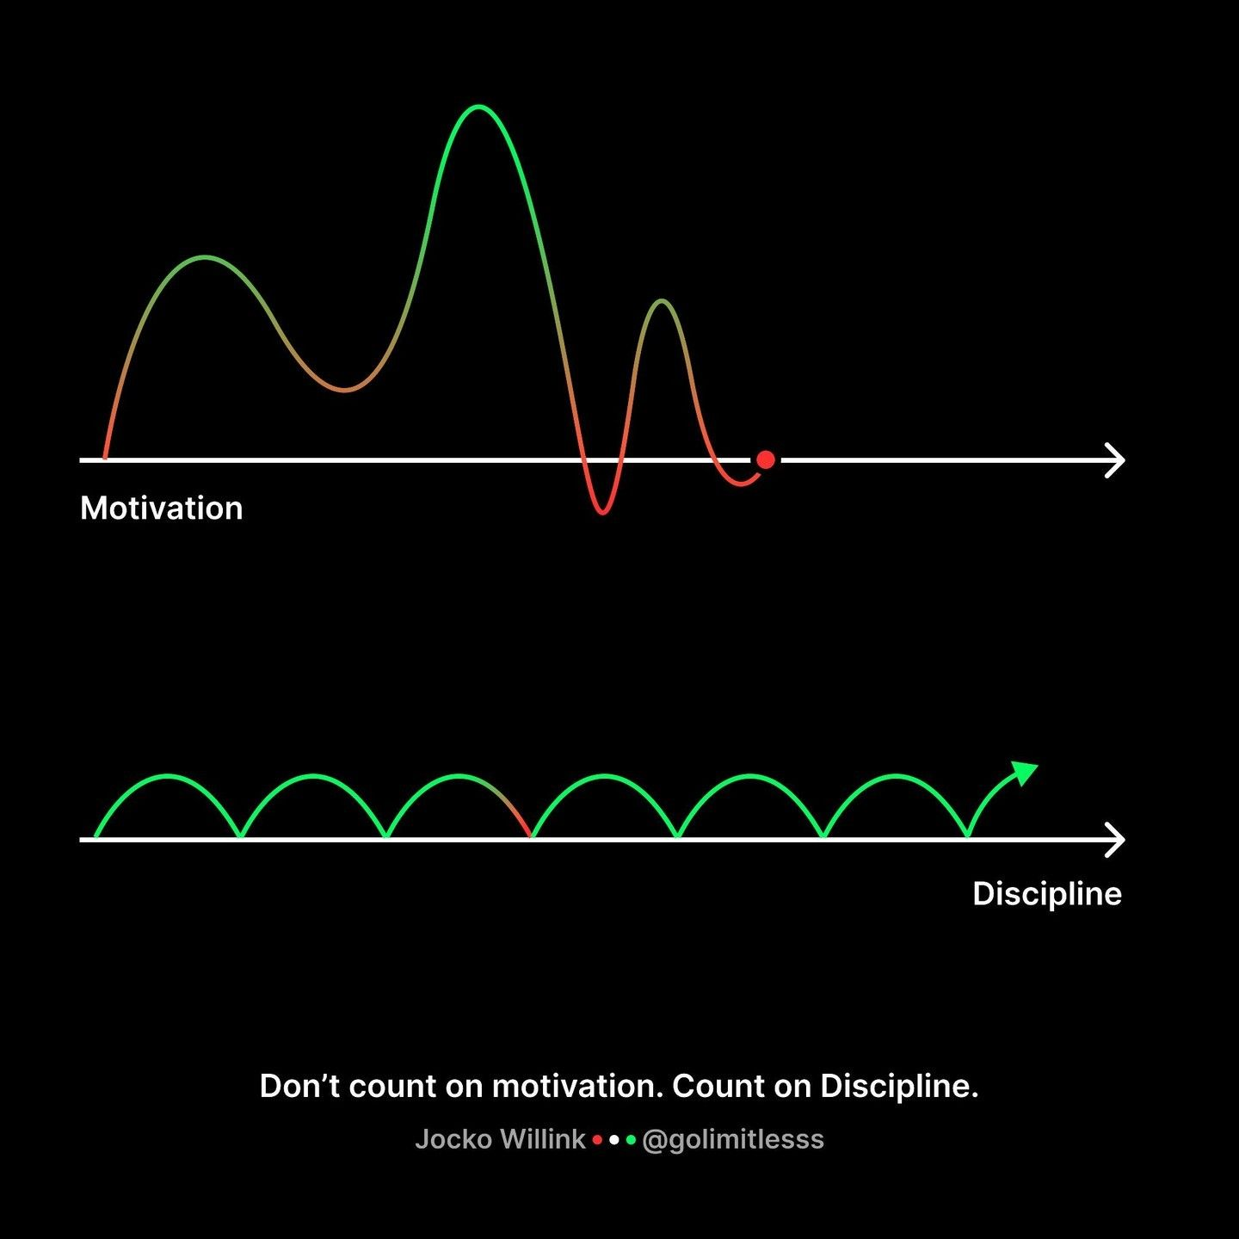

Slide 23
A system built to get you disciplined EVERYDAY…

Slide 24
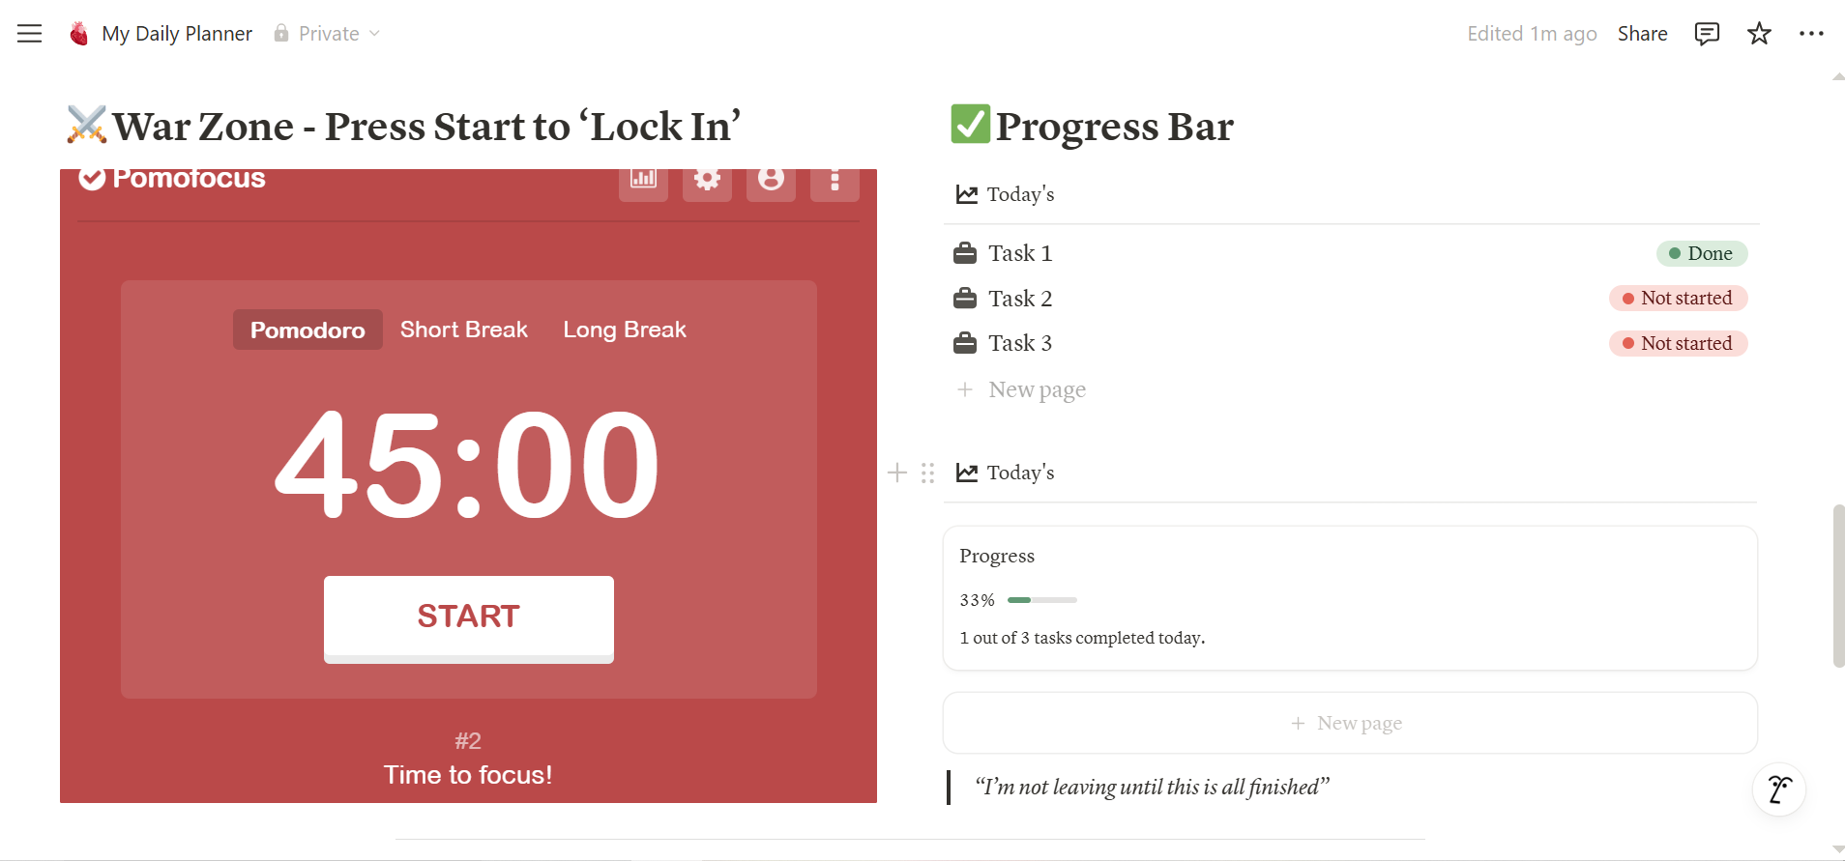

Slide 25
“You are not lazy or stupid, the system you are using is stopping you from succeeding”

Slide 26
Why can’t you stay focused?

Slide 27
Constant Distractions
(Tiktok, Video Games, TVs…)

Slide 28
Design Your Pre-Work Ruleset
Phone away
Chuck coffee
Hit random dance
Turn on music…

Slide 29
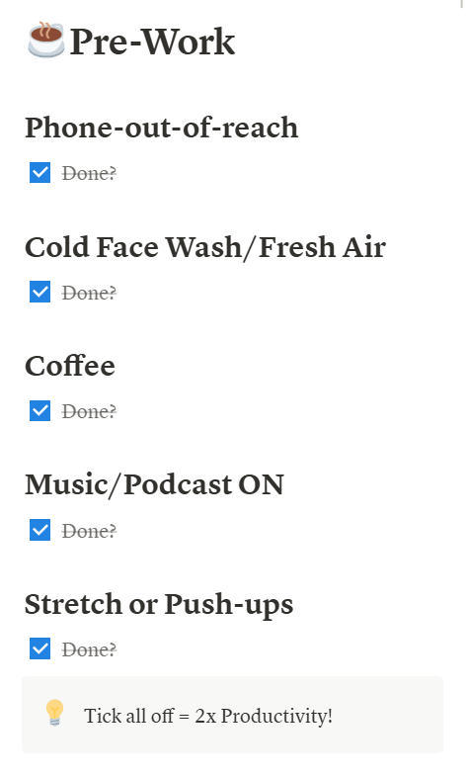
My Pre-Work Ruleset

Slide 30
“Overload & Burnouts”

Slide 31
Trick Your Brain

Slide 32
Sweet Spot for a ‘To-do List’?

Slide 33
Get ‘Power’ from Systemising Your Brain

Slide 34
“I forget everything I just learned”

Slide 35
Spaced Repetition

Slide 36
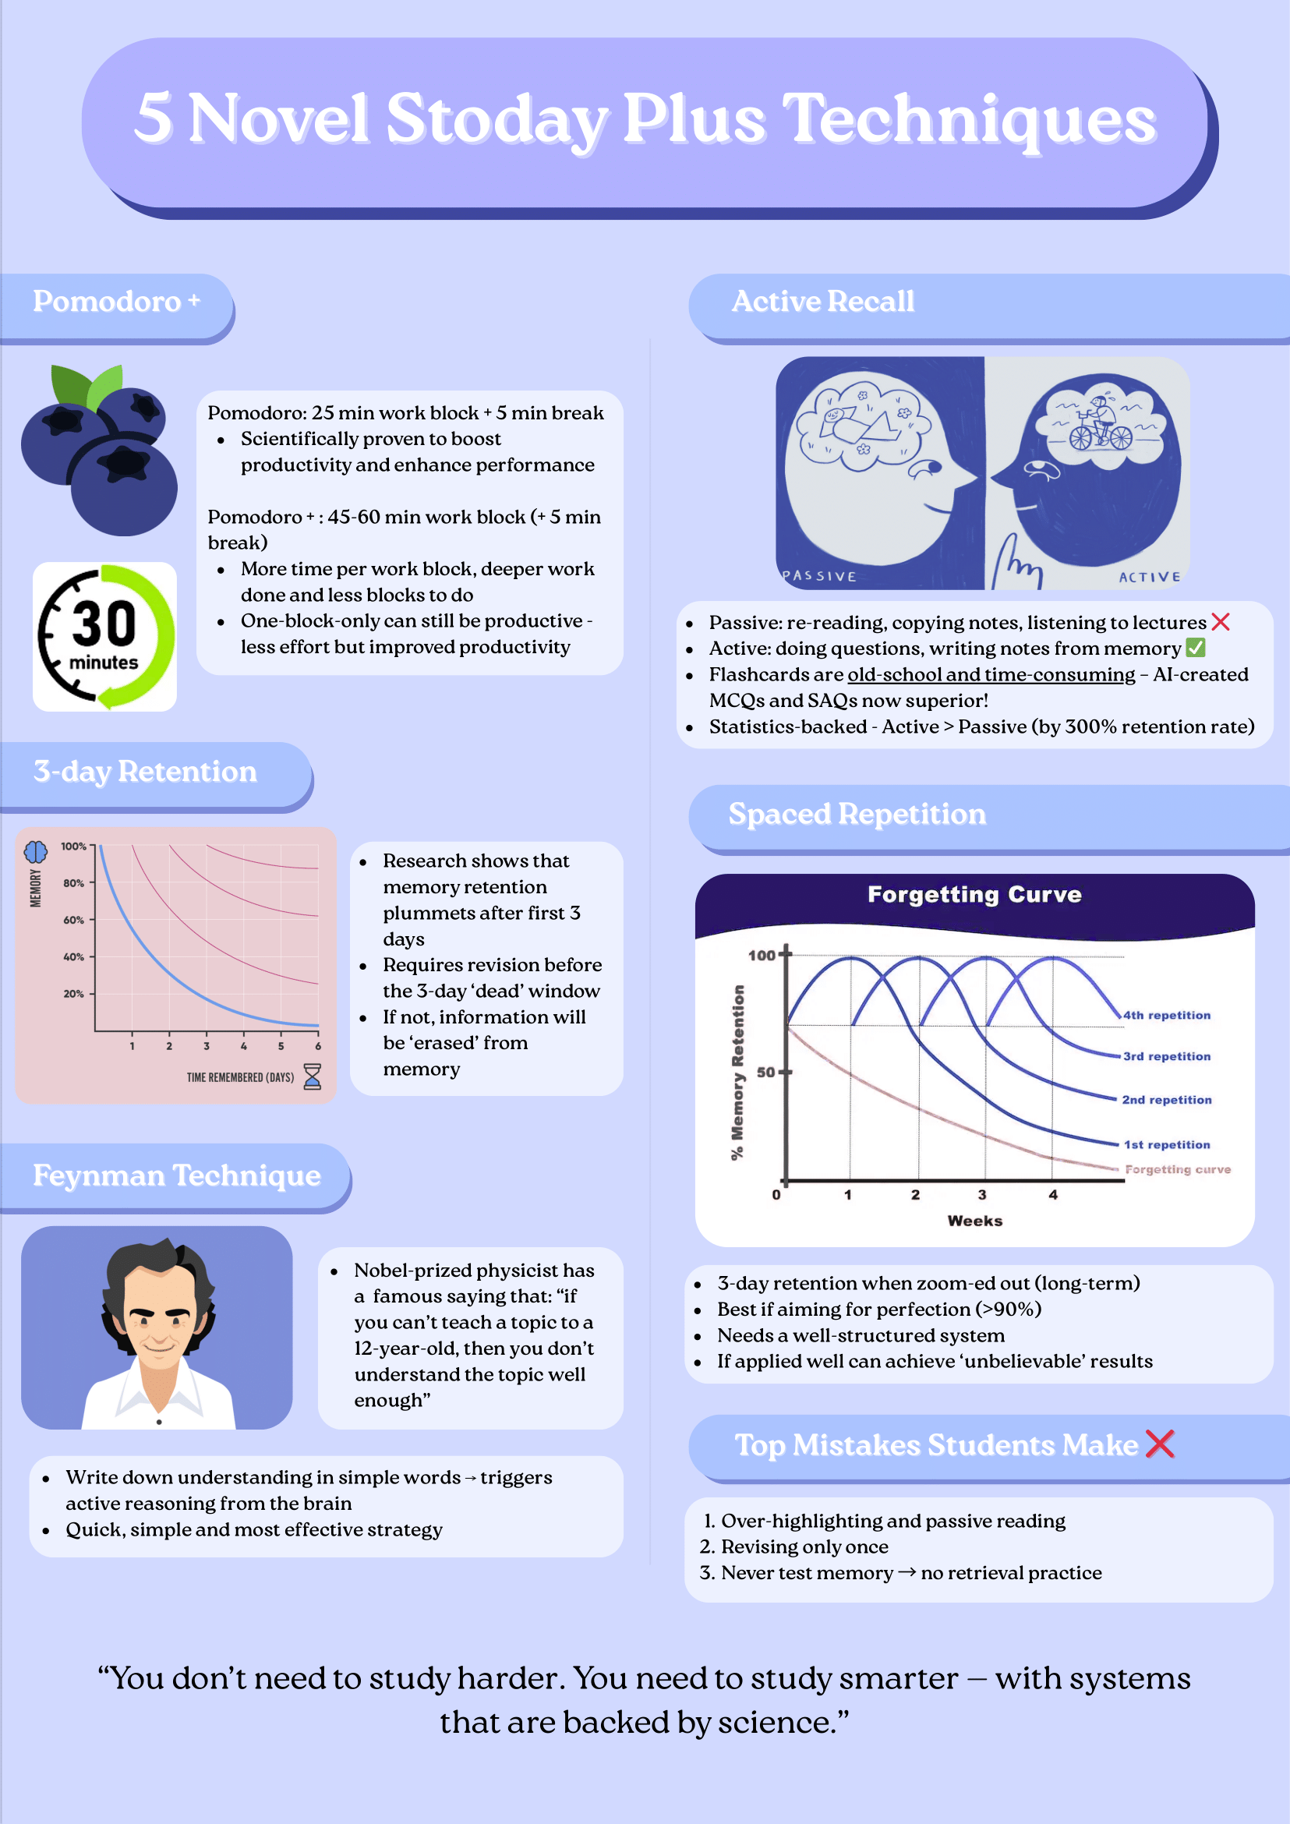

Slide 37
Execute?? (Feynman Technique)

Slide 38
My example: ‘Ovulation’

Slide 39
When an egg is released from the ovary, usually around day 14 of the cycle.

Slide 40
Like releasing a balloon 🎈— the egg floats out of the ovary and is ready to meet sperm.

Slide 41
Before we finish…

Slide 42
Your Promise?

Slide 43
“Next term”
Start earlier
High-paying job
Make parents proud
Respect

Slide 44
A Pre-Built System for you (Plug-and-wait)

Slide 45
Waitlist-ers – 50% Off – First Launch

Slide 46
I Value Your Trust

Slide 47

Scan here ⬇️

Slide 48
See you inside the course! 👋

